Slide 1
MicroCam: Leveraging Smartphone Microscope Camera for Context-Aware Contact Surface Sensing
Authors :YONGQUAN HU, HUI-SHYONG YEO, WEN HU
Tejendra Konduru
700756561

Slide 2
Motivation
The primary focus of this research is the discreet and subtle everyday contact interactions between mobile phones and their surrounding surfaces.
Such interactions are anticipated to facilitate mobile context awareness, encompassing aspects such as dispensing medication updates, intelligently switching modes (e.g., silent mode), or initiating commands (e.g., deactivating an alarm)
The integration of smartphone microscopy with machine learning for context-aware surface sensing is crucial.
Existing solutions like MagicFinger use grayscale images, which limit the classification accuracy.
We introduce MicroCam, a contact-based sensing system that employs smartphone IMU data to detect the routine state of phone placement and utilizes a built-in microscope camera to capture intricate surface details

Slide 3
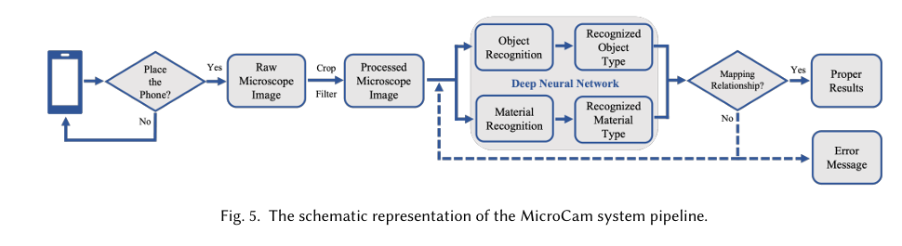
Problem statement
Surface recognition and material classification using traditional methods are limited by the lack of detailed image information.
Grayscale images do not provide enough data to accurately distinguish between similar materials and objects.

Slide 4
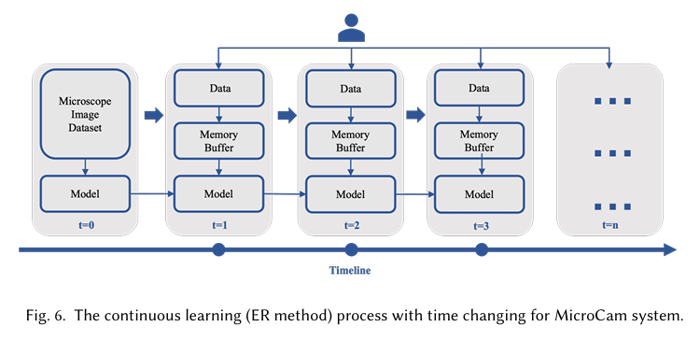
Objectives
To leverage RGB microscopic images for improved surface and material classification.
To optimize the MobileNet-v2 architecture for better performance and lower computational complexity compared to ResNet-50.
To implement continual learning to enhance the system’s adaptability and reduce catastrophic forgetting.

Slide 5
Contributions
Demonstrated the superiority of RGB images over grayscale images for classification tasks.
Achieved high accuracy in object and material classification with MobileNet-v2.
Developed an efficient continual learning strategy to maintain and improve model performance over time.

Slide 6
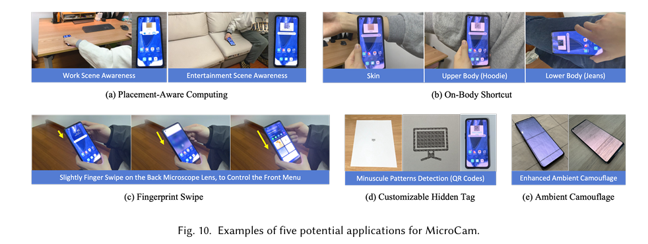
Results We experiment with diferent neural network architectures, a complex and a lightweight architecture, where the results only differ by a little.

Slide 7
Critical Analysis
The reliance on RGB images significantly improves classification accuracy but may require more computational resources.
MobileNet-v2, while lightweight, still faces challenges in extremely complex scenarios.
The continual learning approach, though effective, has room for optimization to further minimize forgetting and enhance forward transfer.

Slide 8
References
Chadia Abras, Diane Maloney-Krichmar, Jenny Preece, et al. 2004. User-centered design. Bainbridge, W. Encyclopedia of Human-Computer Interaction. Thousand Oaks: Sage Publications 37, 4 (2004), 445–456.
Raghav Bansal, Gaurav Raj, and Tanupriya Choudhury. 2016. Blur image detection using Laplacian operator and Open-CV. In 2016 International Conference System Modeling & Advancement in Research Trends (SMART). 63–67. https://doi.org/10.1109/SYSMART.2016. 7894491
P. Buzzega, M. Boschini, A. Porrello, and S. Calderara. 2021. Rethinking Experience Replay: a Bag of Tricks for Continual Learning. In 2020 25th International Conference on Pattern Recognition (ICPR). IEEE Computer Society, Los Alamitos, CA, USA, 2180–2187. https://doi.org/10.1109/ICPR48806.2021.9412614
Rajkumar Darbar and Debasis Samanta. 2015. SurfaceSense: Smartphone Can Recognize Where It Is Kept. In Proceedings of the 7th International Conference on HCI, IndiaHCI 2015 (Guwahati, India) (IndiaHCI’15). Association for Computing Machinery, New York, NY, USA, 39–46. https://doi.org/10.1145/2835966.2835971
AntonellaDeAngeli,Alistair Sutcliffe, and Jan Hartmann.2006. Interaction, Usability and Aesthetics: What Influences Users’ Preferences?. In Proceedings of the 6th Conference on Designing Interactive Systems (University Park, PA, USA) (DIS ’06). Association for Computing Machinery, New York, NY, USA, 271–280. https://doi.org/10.1145/1142405.1142446
Shohreh Deldari, Hao Xue, Aaqib Saeed, Daniel V. Smith, and Flora D. Salim. 2022. COCOA: Cross Modality Contrastive Learning for Sensor Data. Proc. ACM Interact. Mob. Wearable Ubiquitous Technol. 6, 3, Article 108 (sep 2022), 28 pages. https://doi.org/10.1145/3550316 [7] AndroidDevelopers.2021. BatteryHistorian. https://developer.android.com/topic/performance/power/setup-battery-historian Accessed: 2021-07-17.

